Slide 1
1.5 – Linear Functions 1.6 – Linear Regression

Slide 2
1.5 Slope Intercept Form ( Pg 77)
If we write the equation of a linear function in
the form.
f(x) = b + mx
Then m is the slope of the line, and b is the
y-intercept

Slide 3
1.5 Equations of Lines ( Pg 79)
y = 2x + 1
y = 2x
y = ½ x
3
1
-2
y = 2x + 3
y = 2x - 2
y = -2x
These lines have the
same y- intercept but different slopes
These lines have the same slope
but different y - intercepts

Slide 4
1.5 Slope – Intercept Form General y = mx + b ( m is slope of a line, and b is the y- intercept)
Slope- Intercept Method of Graphing
x
New point
y = mx + b
y
b Start here

Slide 5
Point- Slope Form ( pg 82 )
Point- Slope Form y = y₁ + m (x – x₁)
5
x axis
y -3 and point ( 1, - 4)
x = 4
(1, - 4)
( Start point)
- 4
y = -3
( New Point )
- 7
(5, - 7)
x = 4
Plot (1, -4) and move -3 in y-direction and then + 4 in the x-direction to get the
new point(5, -7)

Slide 6
1.5 Slope – Intercept Form y = mx + b ( m is slope of a line, and b is the y- intercept)
3x + 4y = 6 (Subtract 3x from both sides)
4y = - 3x + 6 (Divide both sides by 4)
y = - 3x + 3 ( Isolate Y, divide by 4 )
4 2
_{m =} -3 and _{b =} 3
4 2

Slide 7
Ex1.5, 12 a) Pg 85, Sketch the graph of the line with the given slope and y-intercept b) Write an equation for the line c) Find the x-intercept of the line
m= - 4 and b = 1
1
-1
-2
-3
-4
( 0, 1)
Solution
(1, - 3)
a) Plot y intercept = (0,1) and move - 4 units y-direction down and 1 unit in the x direction( right) to arrive at (1, -3). Draw the line through the two points
b) y= 1- 4x ( y = mx + b, equation of line)
c) Set y= 0,
0 = 1 – 4x ( y = mx = b, Equation )
4x = 1 ( Divide by 4 )
x = ( x- intercept)

Slide 8
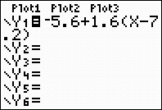
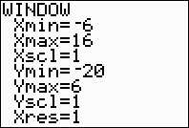
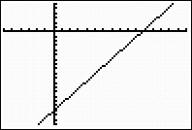
N0 38 a) Write an equation in point slope form for the line that passes through the given point and has the given slope b) Put your equation from part a) into slope –intercept form c) Use your graphing calculator to graph the line (7.2, - 5.6); m = 1.6 Solution
a) y = - 5.6 + 1.6(x – 7.2) { Pt. slope form, y = y₁ + m (x – x₁)}
b) Solve the equation for y
y = - 5.6 + 1.6(x – 7.2)
y = -17.12 + 1.6x (slope intercept form)
C)
Use Graphing Calculator
Hit Y and enter equation Hit window , enter values Hit Graph
[-6, 16,1] by [ -20, 6, 1]

Slide 9
Ch 1.6 Scatter Plots ( pg 94 )
scattered not organized
decreasing trend
increasing trend

Slide 10
1.6 Linear Regression (Lines of Best Fit)
The datas in the scatter plot are roughly linear, we can estimate the location of imaginary ”lines best fit” that passes as close as possible to the data points
We can make the predictions about the data. The process of predicting a value of y based on a straight line that fits the data is called a linear regression, and the line itself called the regression line.
The equation of the regression line is usually used (instead of graph) to predict values

Slide 11
Example of Linear Regression
Estimate a line of best fit and find the equation of the regression line
Use the regression line to predict the heat of vaporization of
potassium bromide, whose boiling temperature is 1435⁰C
200
100
Heat of Vaporization (kJ)
(1560, 170)
Choose two points in the regression line
(900, 100)
1000 2000
Boiling Point ⁰ C
a) Slope ₌ m ₌ 170 – 100 ₌ 0.106
1560 – 900
The equation of regression line is
y- y₁ = m(x – x₁) ( Pt. slope formula)
y – 100 = 0.106(x – 900) , y = 0.106x + 4.6
b) Regression equation for
potassium bromide , x = 1435
y = 0.106(1435) + 4.6

Slide 12
Interpolation- The process of estimating between known data points Extrapolation- Making predictions beyond the range of known data
112
96
80
64
48
Height (cm)
20 40 60 80 100
Age (months)
The graph is not linear because her rate of growth is not constant; her growth slows down
as she approaches her adult height. The short time of interval the graph is close to a line,
and that line can be used to approximate the coordinates of points on the curve.

Slide 13
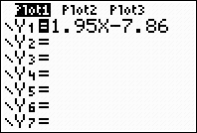
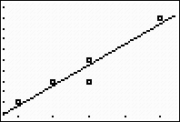
Using Graphing Calculator for Linear Regression Pg – 99 a) Find the equation of the least square regression line for the following data: ( 10, 12), (11, 14), ( 12, 14), (12, 16), ( 14, 20) b) Plot the data points and the least squares regression lin eon the same axes.
Step 1 Press Stat , choose 1 press Enter
Step 2 Enter Y = 1.95x – 7.86
Step 3 Stat, right arrow go to 4 and enter
Step 4 Press Vars 5 ,Right,Right , Enter
Step 5 Press 2nd, Stat Plot 1 and enter
Step 6 Zoom 9

Slide 14
Ex 1.6, Pg - 101 No 4. On an international flight, a passenger may check two bags each weighing 70 kg, or 154 pounds, and one carry –on bag weighing 50 kg, or 110 pounds. Express the weight, p, of a bag in pounds in terms of its weight, k, in kilograms
Solution a)
K( kg) | 70 | 50
P (pounds) | 154 | 110
b) Slope m = 154 – 110 = 44 = 2.2 ( Slope)
70 – 50 20
p = 110 + 2.2 (k – 50) ( pt. slope form )
p = 110 + 2.2k – 110
p = 2.2kg
c) m = 2.2 ib/kg is the factor for conversion from kg to pounds

Slide 15
No 14 The number of mobile homes in the United States has been increasing since 1960. The data in the table are given in millions of mobile homes
Year | 1960 | 1970 | 1980 | 1990 | 2000 2010
Number of mobile homes | 0.8 | 2.1 | 4.7 | 7.4 | 8.8 ?
Let t represent the number of years after 1960 and plot the data. Draw a line
of best fit for the data points
b. Find an equation for your regression line
c. How many mobile homes do you predict for 2010 ?
Solution
Use calculator for the
b) Linear regression with
the points is
y = 0.5 + 0.213t, where
y represents the
number of mobile homes
in millions
c) 2010 , t = 50
y = 0.5 + 0.213t
= 0.5 + 0.213(50)
=11.15
11, 150,000 mobile homes in 2010
12
8
4
Consider 1960 as 0
Half of the points above line
and half of points below the
line
(8.8, 40)
( 30, 7.4)
(4.7, 20)
(2.1, 10)
(0, 0.8)
10 20 30 40 50

Slide 16
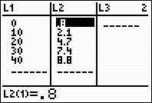
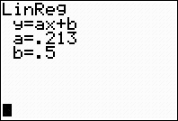
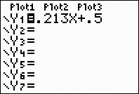
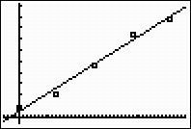
Graphing Calculator
Use page 99 ( Text book)
Press Stat Enter to select Edit.
Enter the
points in L1 and L2 .
( Use the down,up, side arrows),
Press Stat side arrow 4 select
Lin Reg (ax + b) and press
Enter
Press Y1 and press VARS 5
and two sides arrows and
enter
To draw a scatter plot press 2nd Y = 1 and set plot 1 menu then zoom 9

